Slide 1
LSC Learning Management System
Gardon, Jana marie g.
Heramia, johanna marisse c.
Tadeo, jose Lorenzo g.

Slide 2
Loyola Student Center (LSC)
Founded in the early 1980
Established in 1986
Named Solomon’s Ark Computer & Tutorial Services Center

Slide 3
Loyola Student Center (LSC)
Tutorial and Review Facility
High quality and affordable tutorial
Mission: To enhance the intellectual development of students
Vision: To become a center of educational excellence

Slide 4
Current System
Schedule was given manually
Grades cannot access easily
Assignments and quizzes are paper-based

Slide 5
LSC Learning Management System
Frontend:
Track student’s performance
Analyze performance
Notify student if there are tasks
Backend:
Manage courses, tasks and attendance
Create, delete and update courses and tasks

Slide 6
Objective
General Objectives:
To provide efficient way of learning
To provide faster tracking of student’s performance
To provide easier administration
Specific Objectives
To provide system and database
To provide faster administration of records of students
To announce updates faster
To provide easier access on student’s progress

Slide 7
Benefit
To student:
Can use anywhere
Manage performance easier
To parents:
Update about the student’s performance
To administrator:
Give tasks right away
Manage grades and attendance

Slide 8
Purpose
View schedule online
View summary of grades
View attendance online
View students progress
Update information easily

Slide 9
System Features and Functions
For Instructor:
Create course
Record attendance
Create and assign task
Give announcements
For Students:
Access review class
View attendance
Take tasks
See announcements
Keep track of grades

Slide 10
Programming Languages
HTML
CSS
PHP
JQuery
Bootstrap

Slide 11
Specific Software
Windows, Linux and Android
Yii2 advanced framework
Access on browser
MySQL for database
Integrate with the Enrollment System

Slide 12
Hardware Environment
At least 1.3 GHz processor or faster
128 MB RAM
80GB or above
At least 800 x 600 colors or above

Slide 13
Security
System will run inside the firewall
Different roles for admin, student and tutor (RBAC)
Password encryption
Time limit of one hour
No printing and downloading of materials

Slide 14
Application System Modules
Quiz
Course
User

Slide 15
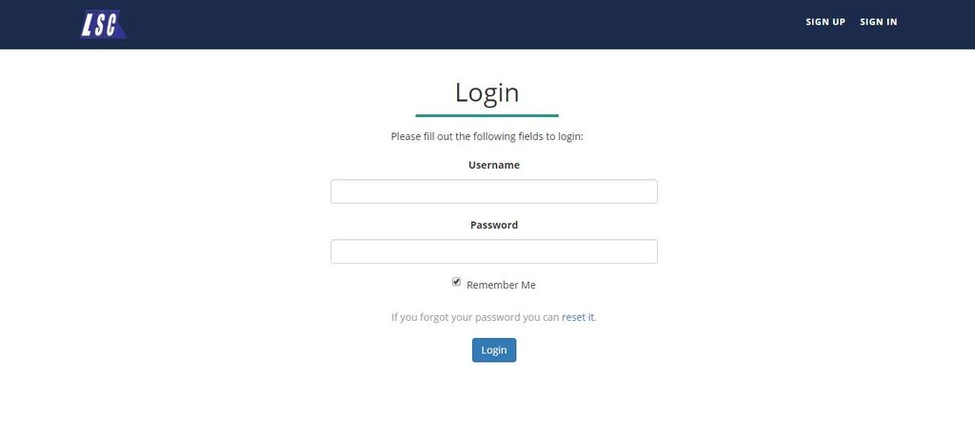
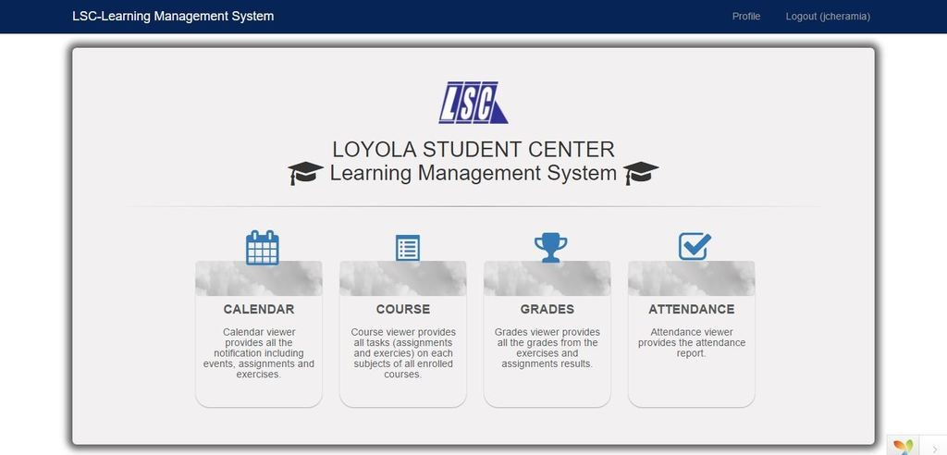
Frontend

Slide 16
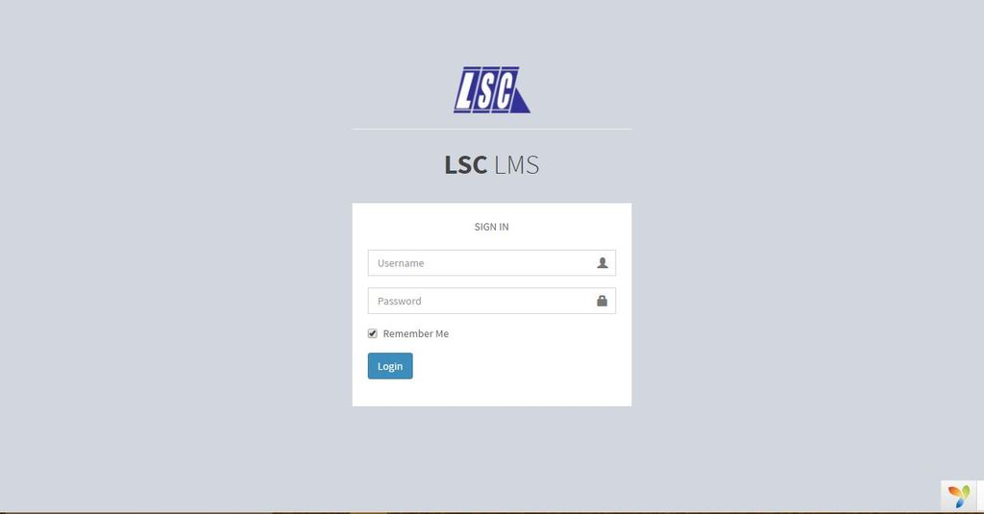
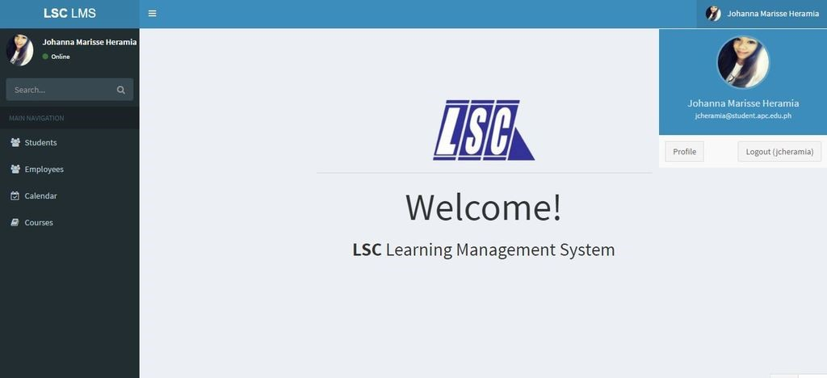
Backend

Slide 17
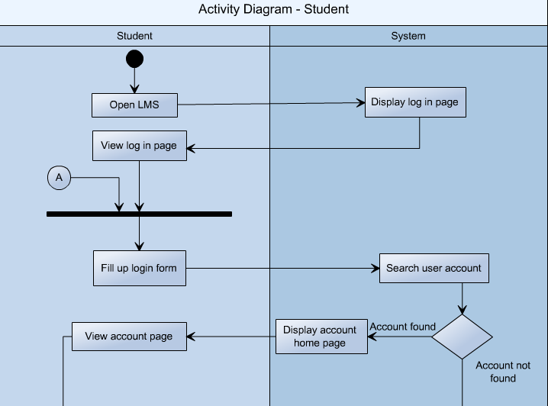
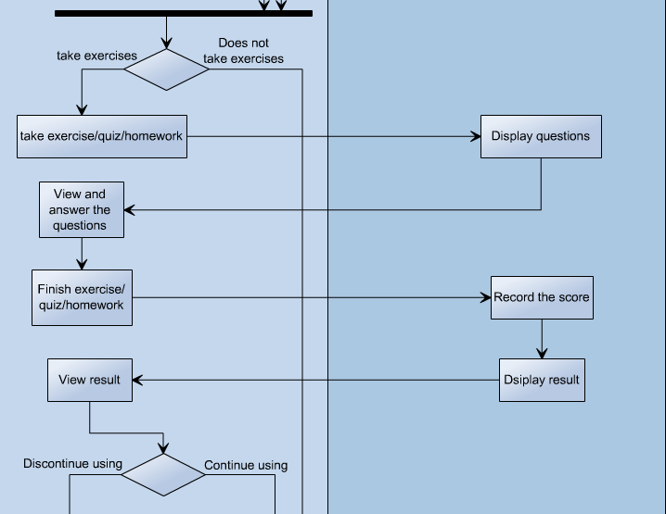
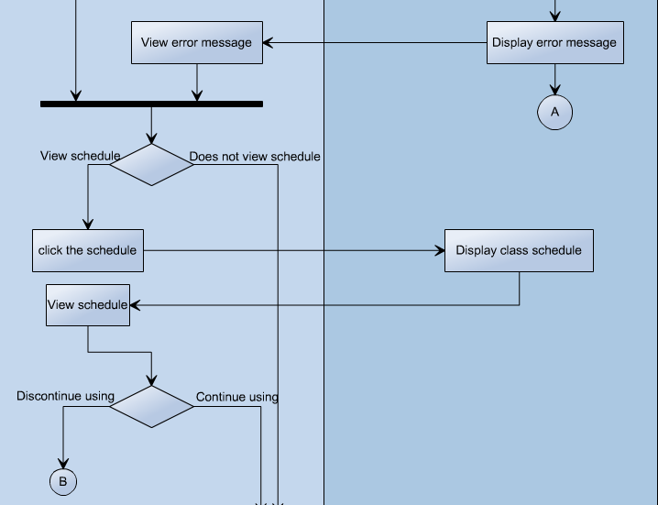
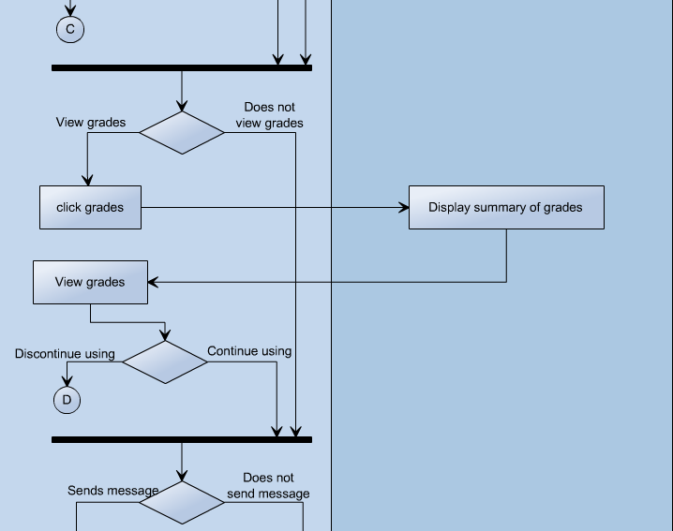

Slide 18
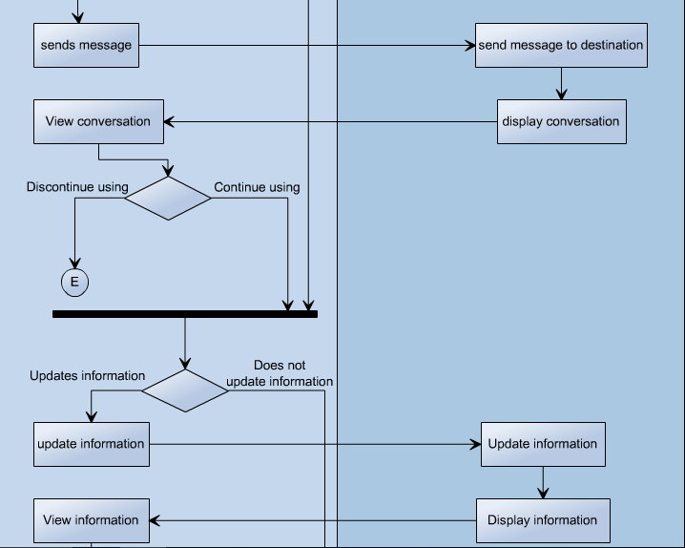
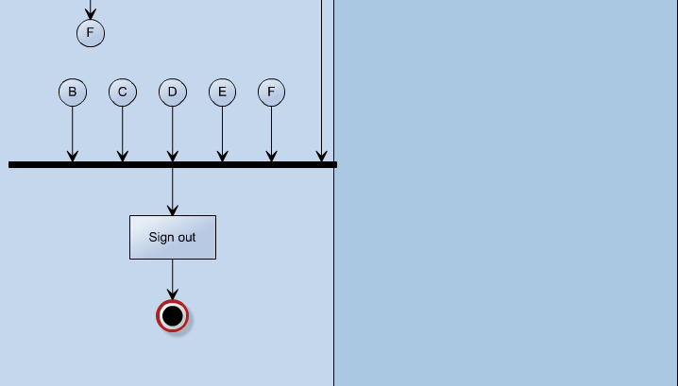

Slide 19
